Slide 1




Film &
Theater
Film
Theater
BOX OFFICE PREDICTION
REGRESSION PROJECT
Project by:Archana Narasimhan
Guided by: Mr. Vijay Kumar
FILM

Slide 2

Film &
Theater
Film
Theater
BUSINESS UNDERSTANDING
Revenue Trends Impact Business Strategy:
Understanding box office revenue trends
HYPOTHESIS
Null Hypothesis (H0): There is no significant difference in domestic revenue between movies of different genres.
Alternative Hypothesis (H1): The genre of a movie significantly affects its domestic revenue.
FILM

Slide 3
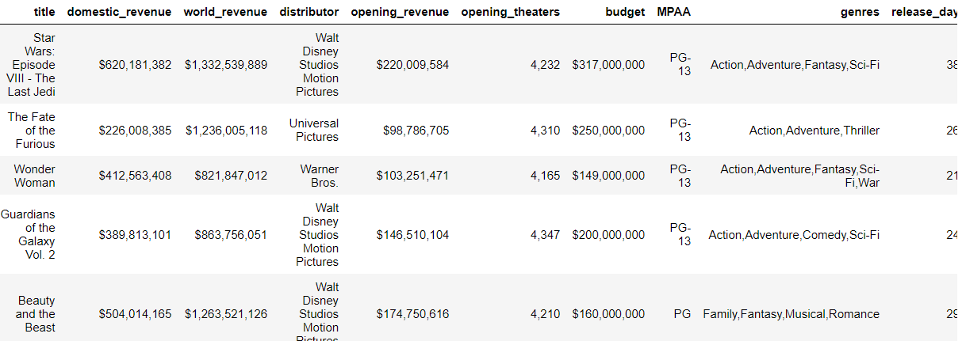

Film &
Theater
Film
Theater
DATA SET / DATA IMPORT
Dataset = boxoffice.csv
Number of observations= 2694
Number of features = 10
Features : title , domestic_revenue, world_revenue, distributor,opening_revenue , opening_theaters, budget, MPAA, genres, release_days
FILM

Slide 4
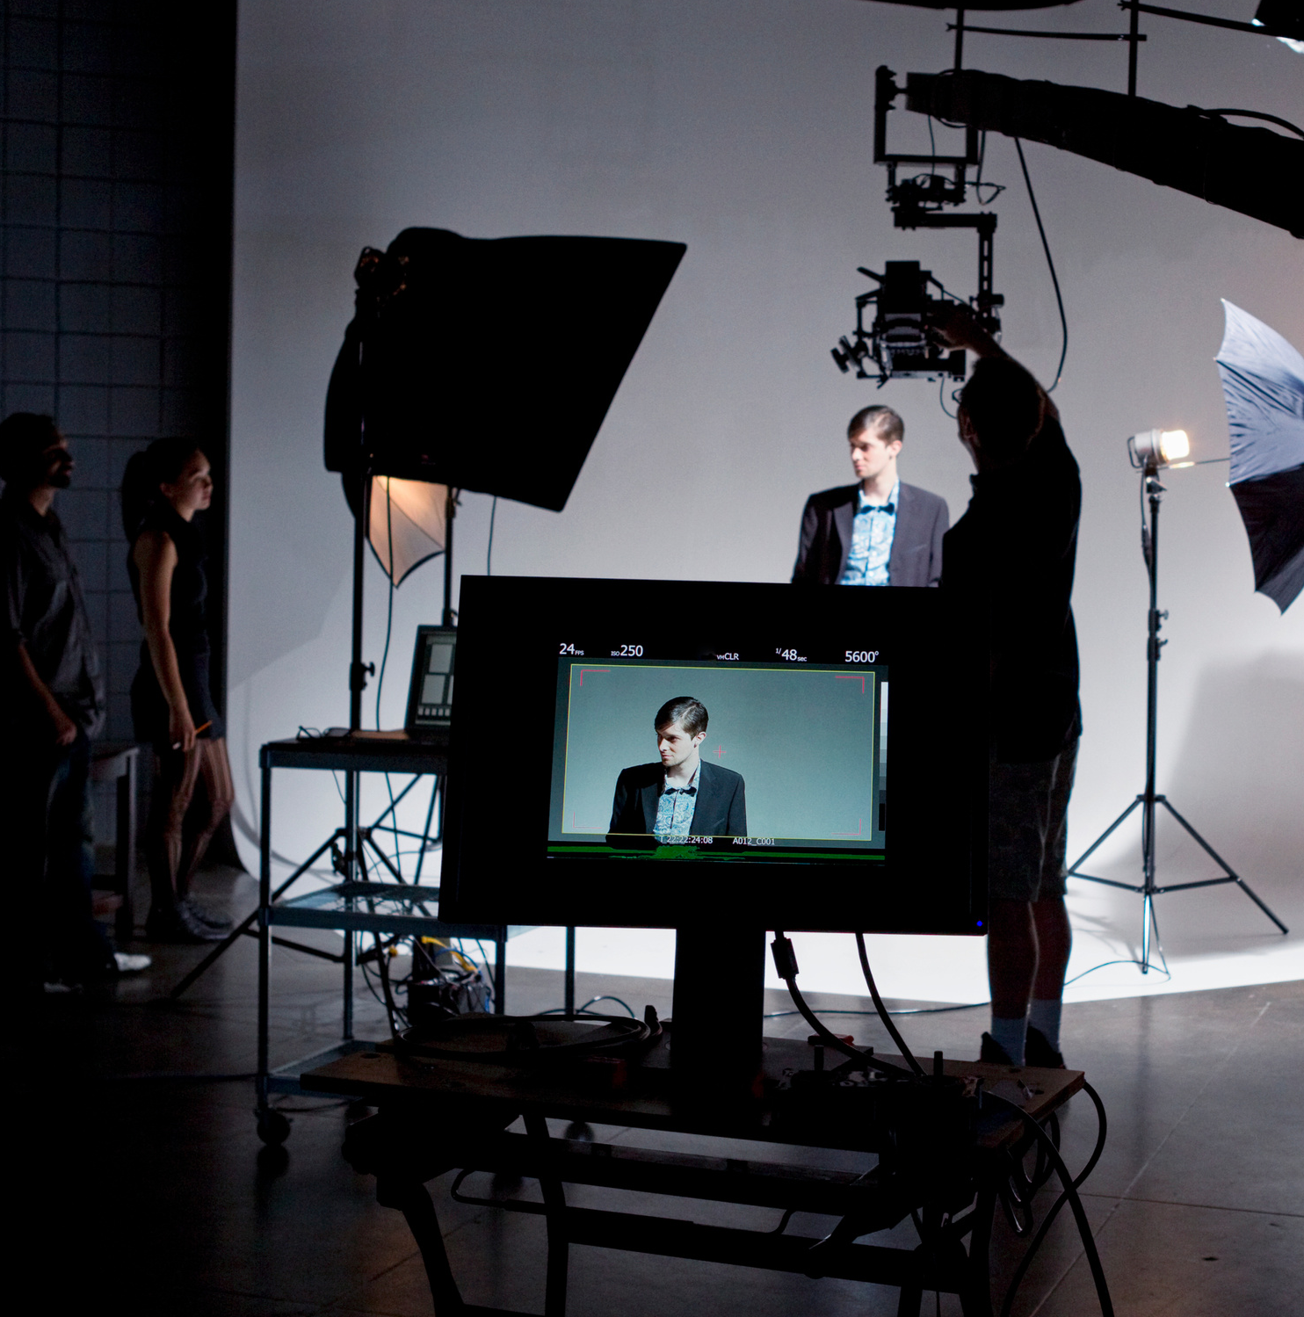
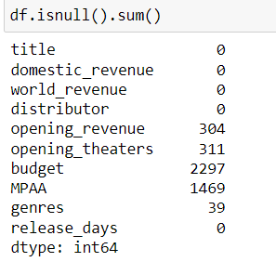
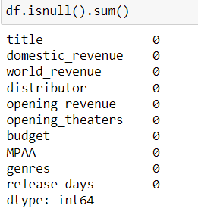
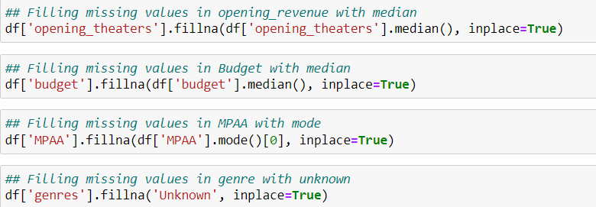
Film &
Theater
Film
Theater
DATA PREPROCESSING / DATA CLEANING
MISSING VALUES
IMPUTATION
BEFORE IMPUTATION
AFTER IMPUTATION
FILM

Slide 5


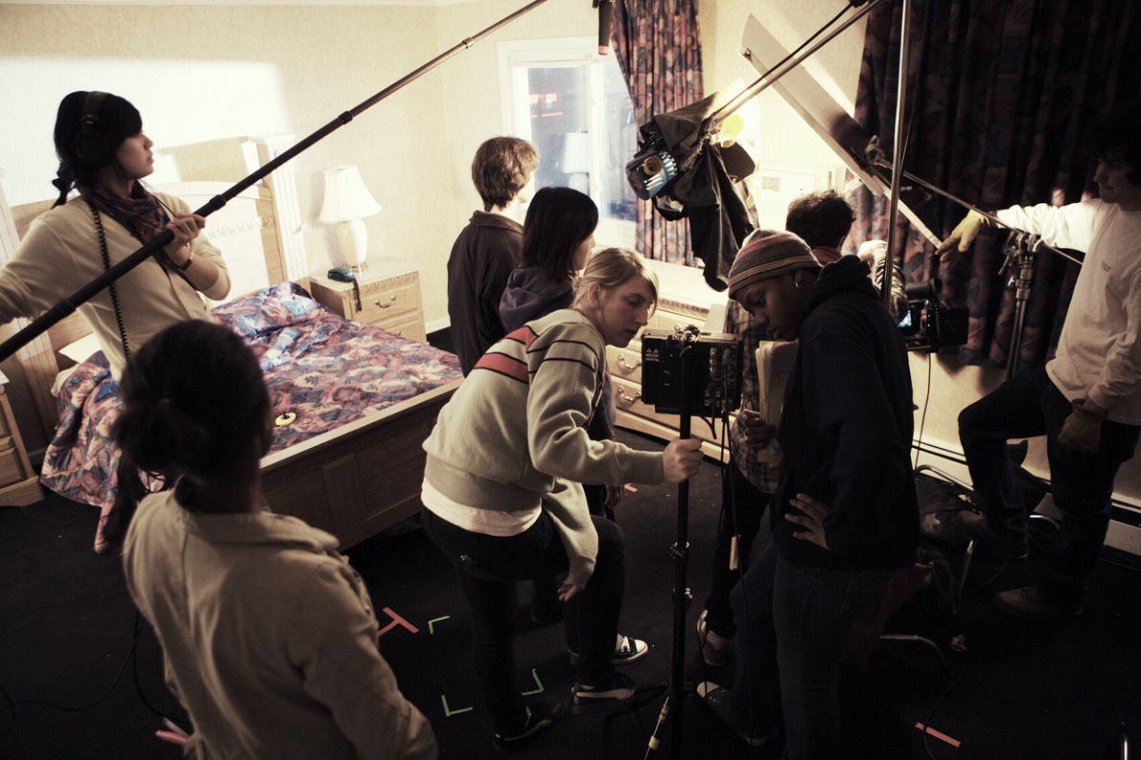
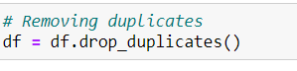
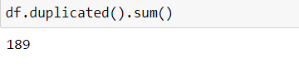
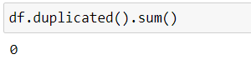
Film &
Theater
Home
Film
Theater
DATA PREPROCESSING / DATA CLEANING
DUPLICATES
DROPPING
BEFORE
AFTER
FILM

Slide 6
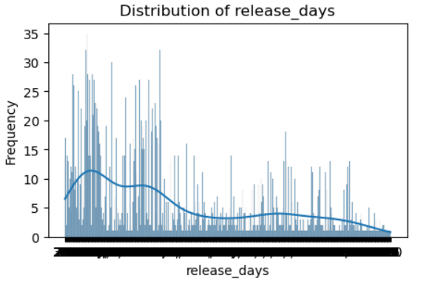
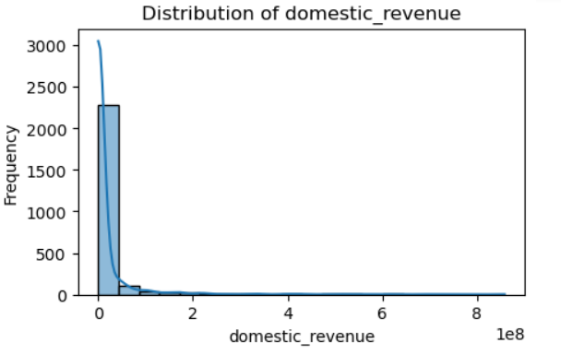

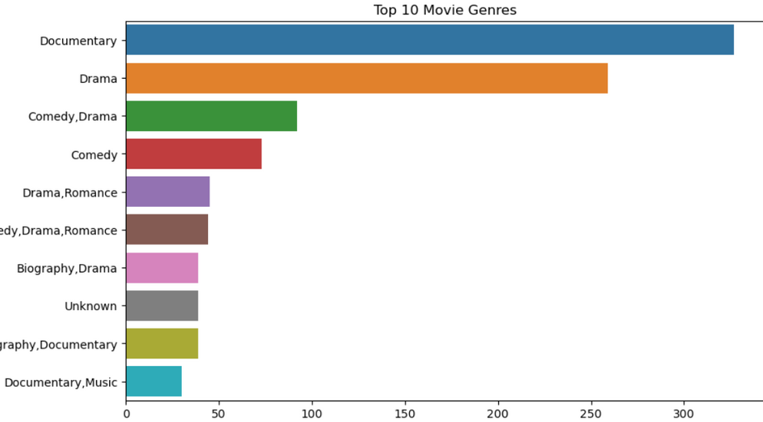
Film &
Theater
EXPLORATORY DATA ANALYSIS
Film
Theater
UNIVARIATE ANALYSIS

Slide 7

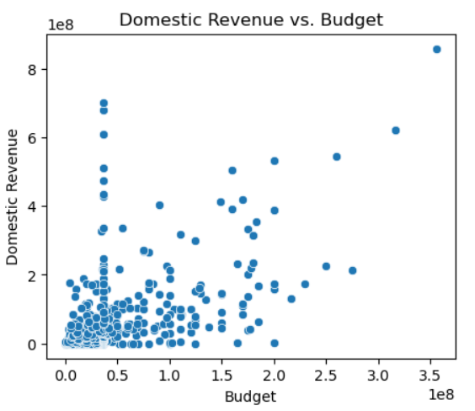
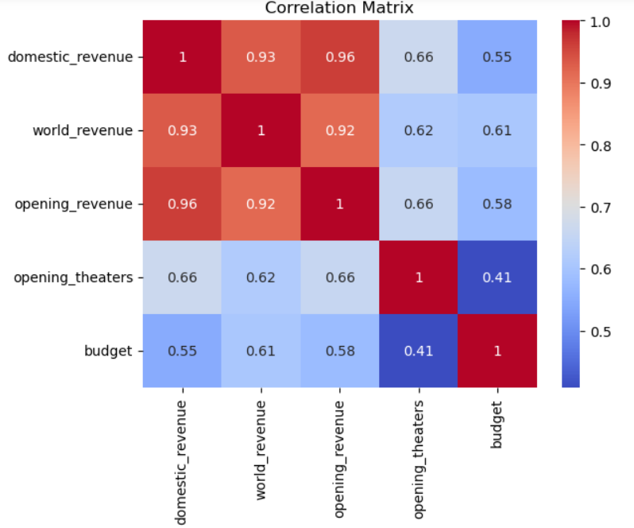
Film &
Theater
Film
Theater
BIVARIATE ANALYSIS
CORRELATION
Senior Director
FILM

Slide 8
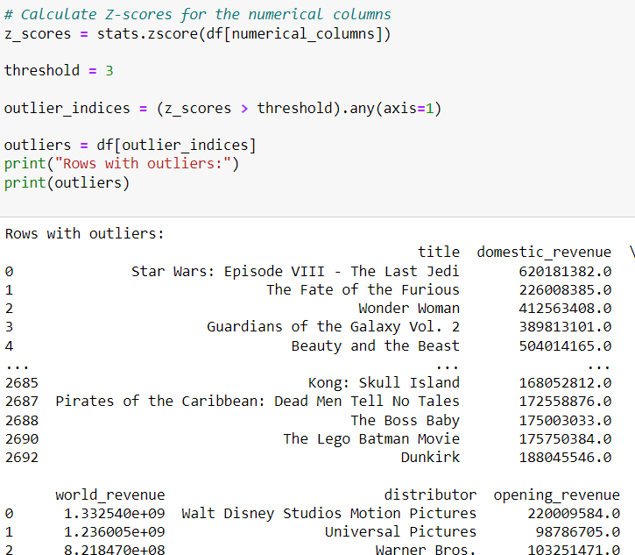
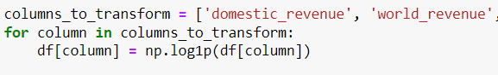
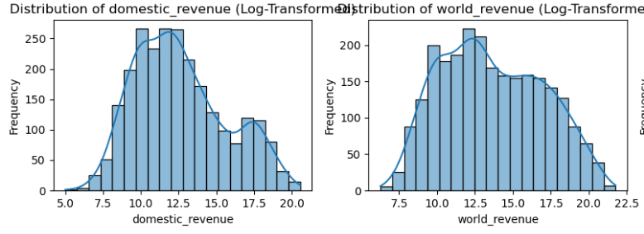
Film
OUTLIERS / LOG TRANSFORMATION
Film &
Theater
Theater
BEFORE
AFTER
FILM

Slide 9
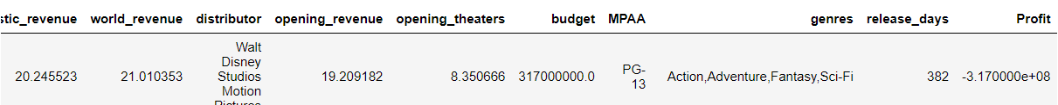



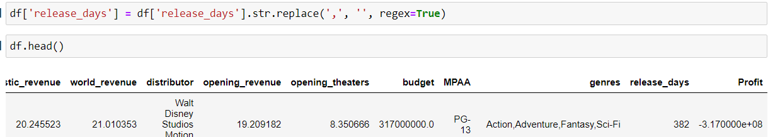
Film &
Theater
Film
Theater
FEATURE ENGINEERING/ SELECTION
Creating feature : Profit
Replacing string :release days
Harper Russo
Estelle darcy
Daniel Gallego
FILM

Slide 10
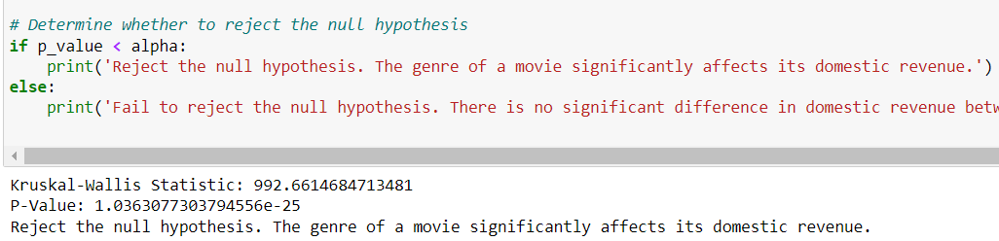
Film &
Theater
Film
Theater
STATISTICAL ANALYSIS
Kruskal-Wallis Statistic: 992.6614684713481
P-Value: 1.0363077303794556e-25
We reject the null hypothesis and conclude the genre of a movie significantly affects its domestic revenue.
FILM

Slide 11
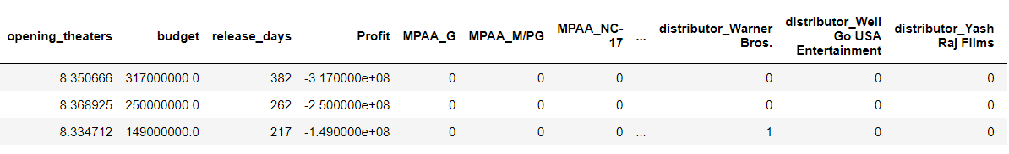
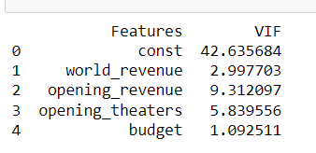
Film &
Theater
Film
Theater
ENCODING / MULTICOLLINEARITY
ONE HOT ENCODING - MPAA, GENRES, DISTRIBUTOR
MULTICOLLINEARITY
FILM

Slide 12
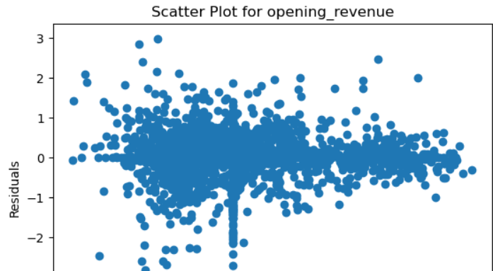
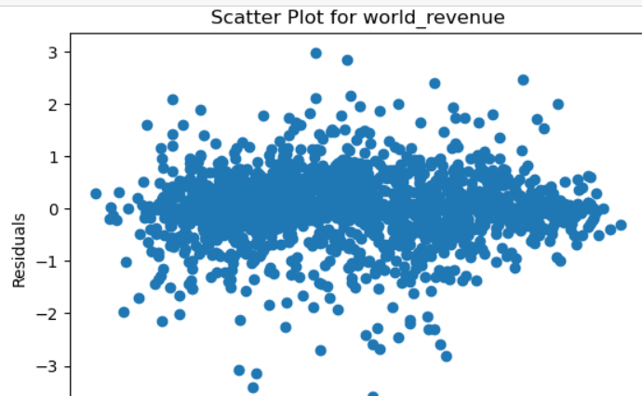
Film &
Theater
ASSUMPTIONS
Theater
LINEARITY, INDEPENDENCE, HOMOSCEDASTICITY, NORMALITY
The assumption of independence in linear regression appears to be met as the Durbin-Watson test indicates relatively independent residuals (p-value > 0.05).
There is some evidence that the residuals may not be perfectly normally distributed, but the Shapiro-Wilk test result (p-value <= 0.05) may not severely impact the analysis, especially with a large sample size.
FILM

Slide 13
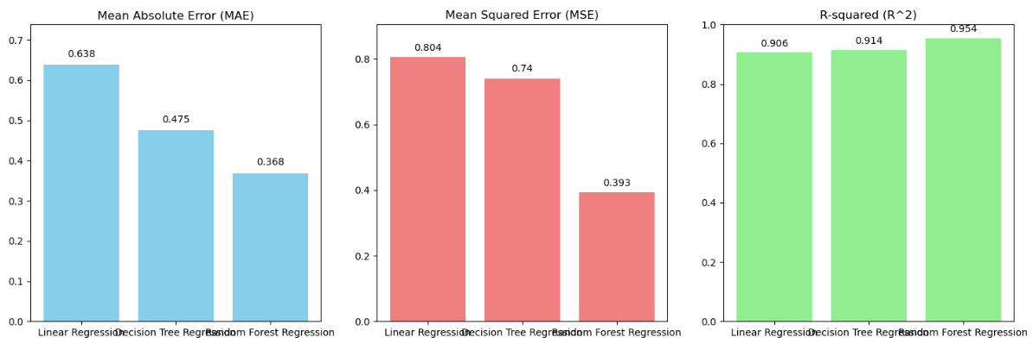
Film &
Theater
Film
Theater
MODEL SELECTION/ MODEL EVALUATION
FILM

Slide 14
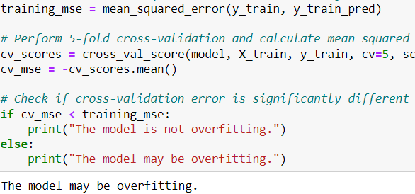
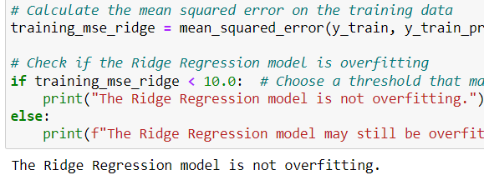
Film &
Theater
Film
Theater
L2 REGULARIZATION
RIDGE REGRESSION
OVERFITTING
FILM

Slide 15
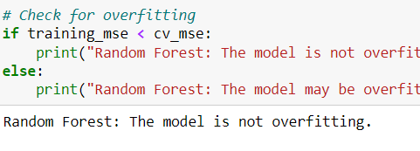
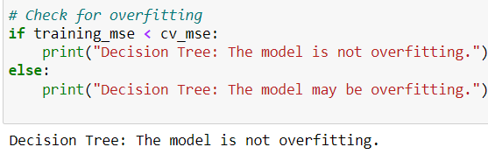
Film &
Theater
Film
Theater
OVERFITTING
FILM

Slide 16
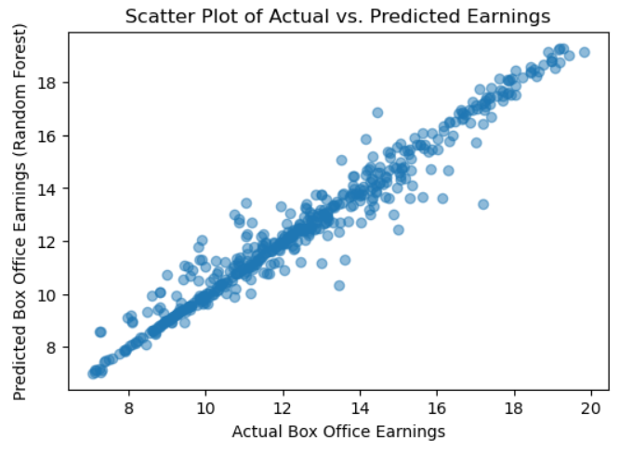
Film &
Theater
Film
Theater
VISUALIZING PREDICTIONS
FILM

Slide 17
Film &
Theater
Film
Theater
CONCLUSION / RECOMMENDATIONS
High R-squared values in Linear, Decision Tree, and Random Forest models explain a significant portion of box office earnings variance.
Low MAE and MSE in Random Forest models demonstrates it is accurately able to predict our box office revenue with less error.
We can Implement collaborative filtering for personalized movie recommendations.
FILM

Slide 18


THANK YOU
DSP PYTHON PROJECT
BY ARCHANA NARASIMHAN
FILM

